Slide 1
PEP 8

Slide 2
Agenda
Intro
What is it?
Why should You use it?
How to get started
Examples
Questions

Slide 3
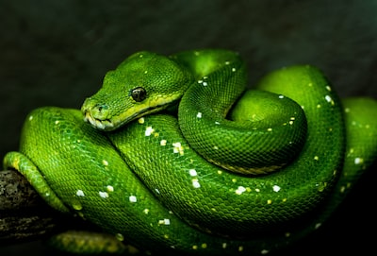
Python
Python is a great programming language. Tool known as the second best language for literally everything. As a dynamically typed programming language it comes with no type checking, no strict structure etc.

Slide 4
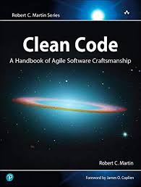
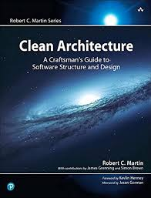
"Clean code always looks like it was written by someone who cares." - Robert C. Martin

Slide 5
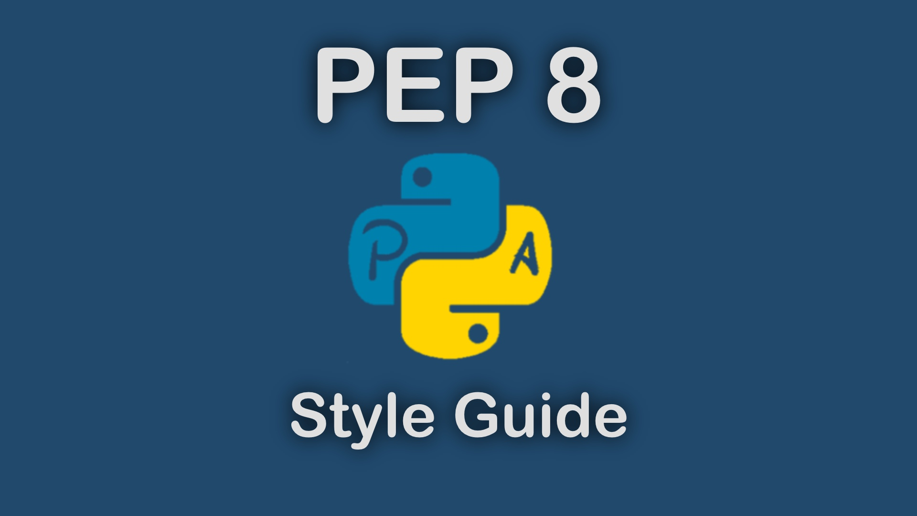
What is it?

Slide 6
Intro
PEP 8 stands for "Python Enhancement Proposal 8." It is a document that provides guidelines and recommendations for writing Python code in a consistent and readable manner. PEP 8 was created by Guido van Rossum, the original creator of Python, and is considered the official style guide for Python programming.
The main purpose of PEP 8 is to promote code readability and maintainability, making it easier for developers to understand and collaborate on Python projects. The guidelines cover various aspects of code formatting, naming conventions, comments, and overall code structure.

Slide 7
Do companies actually use PEP8?
The most reasonable ones do. They will not even allow you to commit your code if it is not embracing the standards. So why should we be any different than that?

Slide 8
Readability
The Zen of Python emphasizes readability as a fundamental principle. PEP 8 aligns perfectly with this philosophy, as it encourages developers to write code that is easy to understand and follow. Consistent indentation, naming conventions, and spacing help reduce cognitive load, enabling developers to comprehend code more quickly. By adhering to PEP 8, your code becomes more readable and accessible to others, including your future self.

Slide 9
Maintainability
Software projects often undergo multiple phases, from development to maintenance and collaboration. Writing code that follows PEP 8 ensures that others can easily navigate and modify it. Consistent formatting and styling enhance code maintainability by minimizing confusion and reducing the time required for code reviews, debugging, and refactoring. By adopting PEP 8, you pave the way for smoother collaboration and long-term project success.

Slide 10
Code Consistency
Consistency is key to writing clean code, and PEP 8 provides a set of rules that establish a consistent coding style across Python projects. Whether you're working on a personal project or contributing to an open-source endeavor, adhering to PEP 8 fosters uniformity throughout the codebase. This consistency promotes code reusability, improves teamwork, and makes it easier to integrate different modules or libraries into your code.

Slide 11
Enhancing Debugging and Troubleshooting
Debugging can be a challenging aspect of software development, but adhering to PEP 8 can significantly simplify this process. Consistent formatting and standardized naming conventions reduce the likelihood of introducing syntactic errors and typos. Additionally, adhering to PEP 8 recommendations helps linters and code analysis tools work effectively, highlighting potential issues early on. This way, you can catch bugs and troubleshoot errors more efficiently.

Slide 12
Industry Best Practices
Python is widely used across various domains and industries. By writing code that aligns with PEP 8, you adhere to industry best practices and established conventions. This not only demonstrates professionalism but also facilitates collaboration with other developers. Whether you're contributing to open-source projects or seeking employment opportunities, adhering to PEP 8 showcases your commitment to high-quality coding standards and increases your credibility as a developer.

Slide 13
Future-proofing
The world of technology is constantly evolving, and programming languages evolve alongside it. By embracing PEP 8, you future-proof your codebase to a certain extent. As the Python community grows and new libraries, frameworks, and tools emerge, the adoption of PEP 8 ensures that your code remains compatible and adaptable. Staying in sync with the community's evolving standards allows for seamless integration with new updates and advancements in Python.

Slide 14
some examples

Slide 15
Questions

